Slide 1
Continuous Weather Forecasting Using Autonomous Deep Learning
Shijia Yan
Pratama, Mahardhika, et al. "Autonomous deep learning: Incremental learning of denoising autoencoder for evolving data streams." arXiv preprint arXiv:1809.09081(2018).

Slide 2
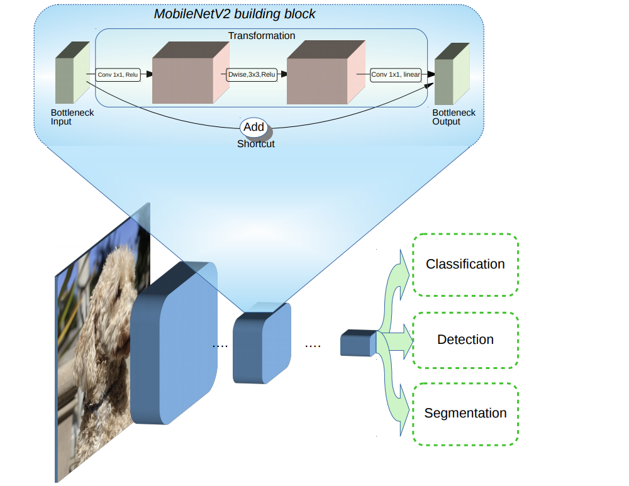

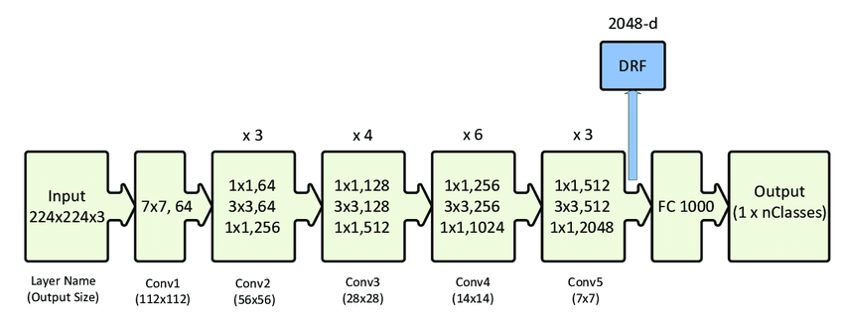
What network to choose?
MobileNetV2
VGG16
ResNet50

Slide 3
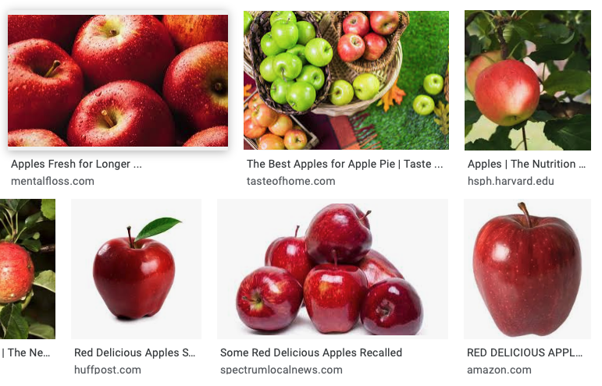
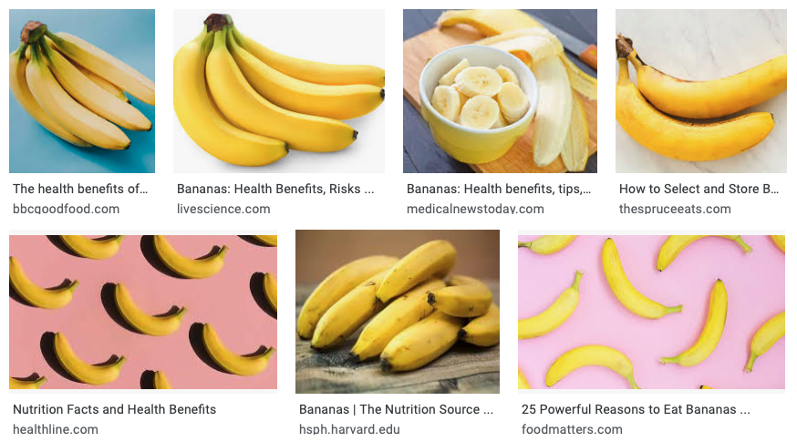
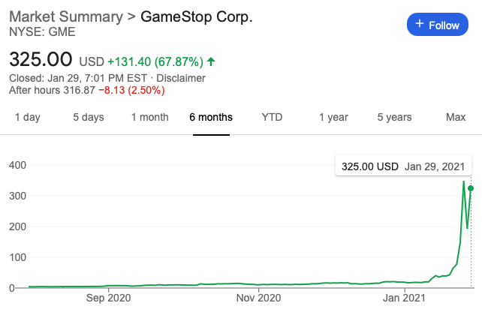
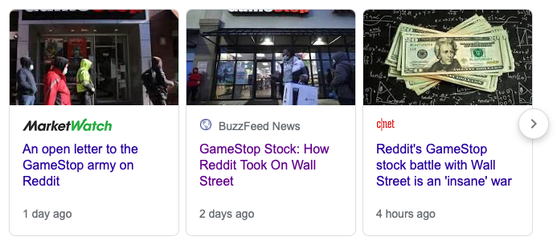
Complexity varies
Case 1:
Distinguish apples from bananas
Case 2:
Predict stock prices from news data

Slide 4
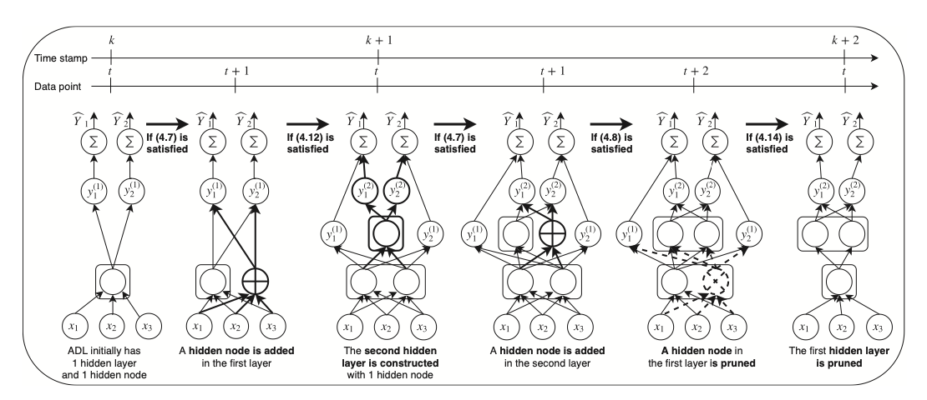
Autonomous DNN: adaptive network size
Example of an automated DNN construction
Ashfahani, Andri, and Mahardhika Pratama. "Autonomous deep learning: Continual learning approach for dynamic environments." Proceedings of the 2019 SIAM International Conference on Data Mining. Society for Industrial and Applied Mathematics, 2019.

Slide 5
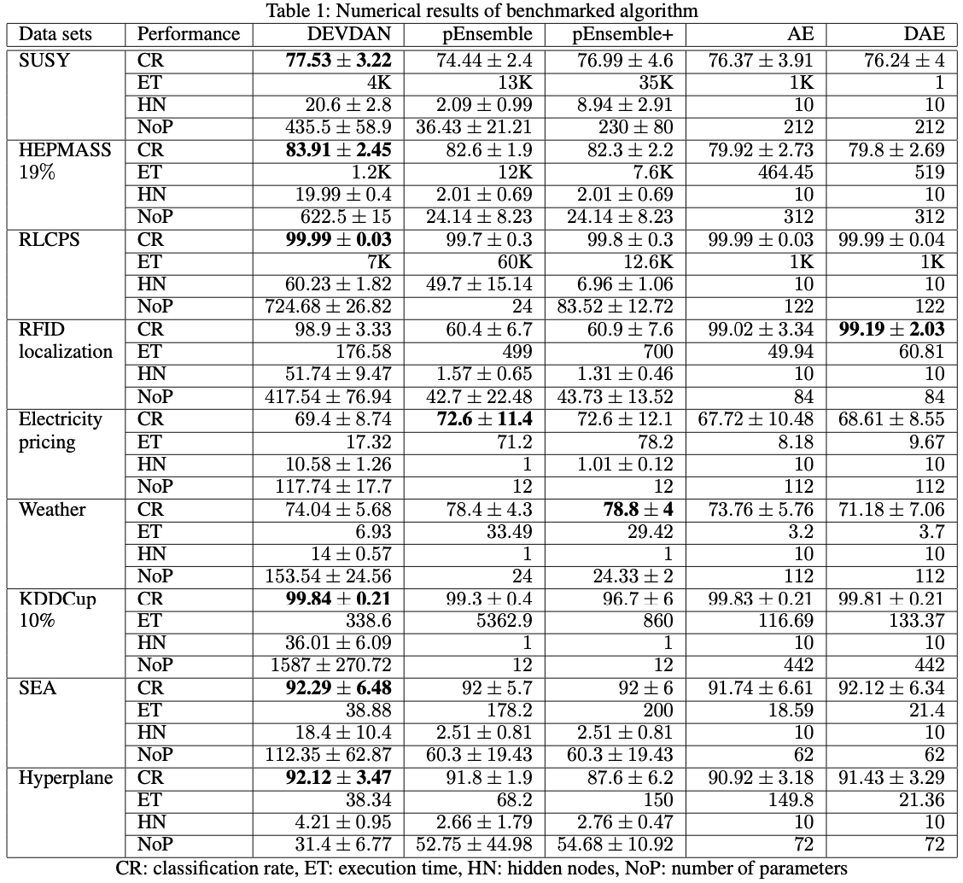
Published Results
Pratama, Mahardhika, et al. "Autonomous deep learning: Incremental learning of denoising autoencoder for evolving data streams." arXiv preprint arXiv:1809.09081(2018).

Slide 6
Continuous Weather Forecasting Using Autonomous Deep Learning
Shijia Yan
Pratama, Mahardhika, et al. "Autonomous deep learning: Incremental learning of denoising autoencoder for evolving data streams." arXiv preprint arXiv:1809.09081(2018).

Slide 7
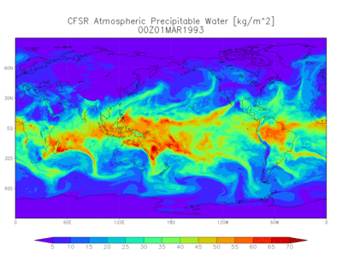
Dataset
Several categories of model data are available through NOAA's National Operational Model Archive and Distribution System (NOMADS). These broad categories of data are Reanalysis, Numerical Weather Prediction, Climate Prediction, and Derived/Other Model Data.
However these data are formatted in different types – needs decoding and reformatting

Slide 8
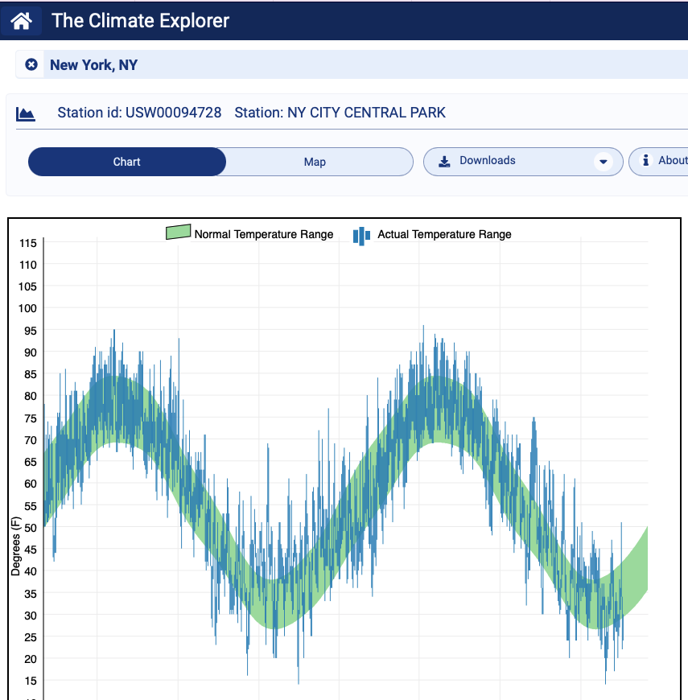
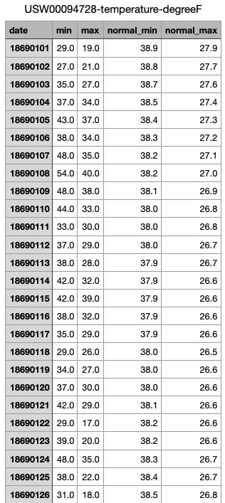
Dataset
https://crt-climate-explorer.nemac.org/historical-weather-data/?county=New%20York%20County&city=New%20York%2C%20NY&fips=36061&lat=40.71&lon=-74.01&nav=historical-weather-data&station=USW00094728&station-name=NY%20CITY%20CENTRAL%20PARK&mode=daily_vs_climate&zoom=9

Slide 9
Learning Mechanism
Testing
Learning
Input Feature Growing – Bias Method
Input Feature Pruning – Variance Method
Parameter Tuning - SGD
Encoding
Hidden Layer Growing/Pruning
Integrate Softmax
Hidden Layer Training (Parameter Tuning)

Slide 10
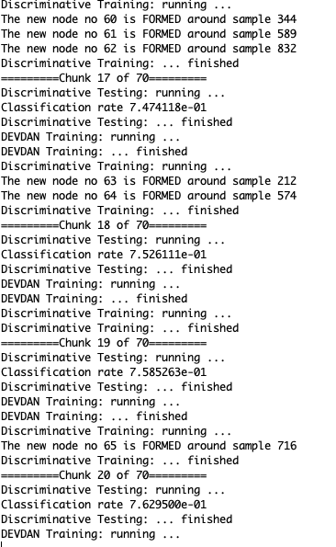
Implementation
Implemented autonomous neural network w/ mnist

Slide 11
Next Steps
Obtain more detailed weather data by using NOAA data decoder
Or find other data sources that uses more friendly data formats
Reformat data into usable dataset
Training & Validating
Weather Real-Time Forcasting Web
To support several different areas/cities
Obtain real-time weather data from other apis
Predict future weather with trained autonomous NN
Display prediction to user

Slide 12
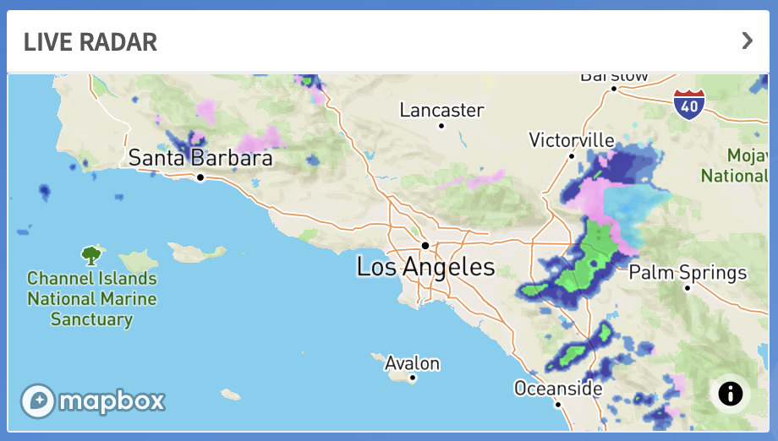
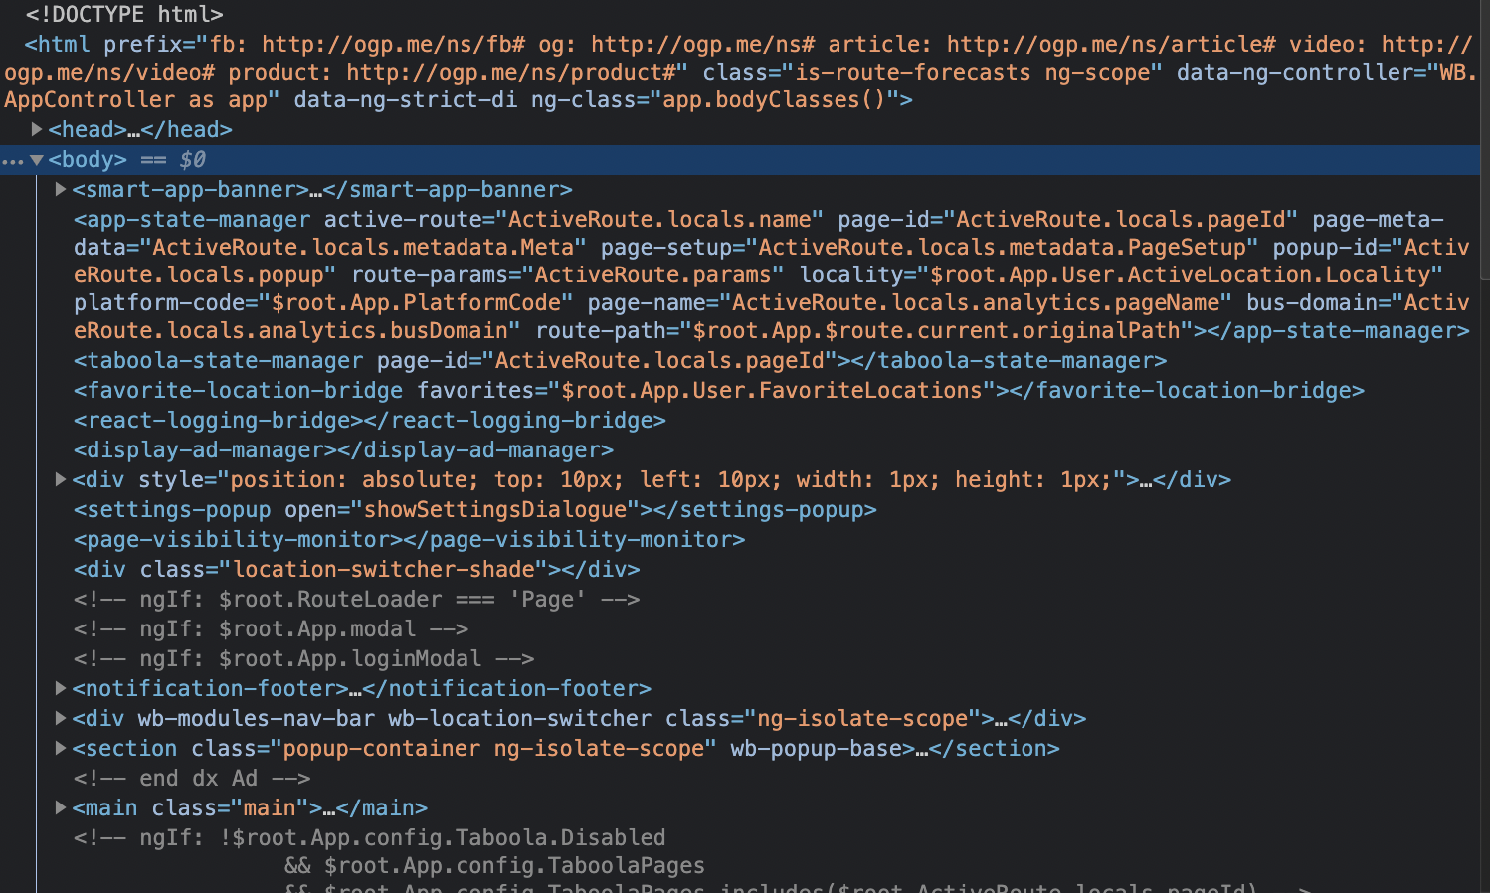
Real-Time Forcasting
Web Scraping From weatherbug.com\
Live scraping w/ python

